Slide 1
Predicting Out of Stock:
A survival model based approach
By :- Abhey Arora
Mentor – Subhadip Bandyopadhyay

Slide 2
OOS: The phenomenon and the importance
OOS: An item is not available in a store; common phenomenon in retail world
Impacts
Short term: Loss of sale; Demand transfer to similar items
Long term: Impacts on brand image; disengaged and finally lost guests
Even a 1% decrease in OOS can have millions of dollar saving for a large retail organization like Target
Problem Statement :- Predicting out of stock of an item at a location
Notes:
Improvement of OOS forecasting can be a game changer

Slide 3
Divisions and Departments with High Out of Stock Occurrences
Division 19
Dept. : 71
SNACKS/BEV/CANDY
Division 29
DRY/DAIRY/FROZEN
Dept. : 231
Division 32
BEAUTY
Dept. : 37,49,52,63

Slide 4
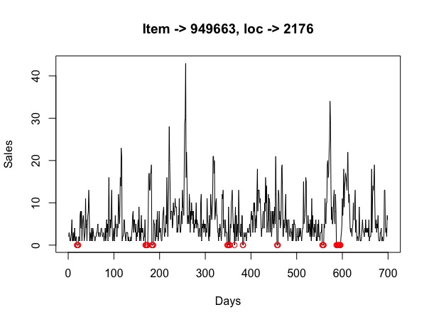

Slide 5
Defining Out of Stock
OOS is when beginning of hand quantity <= 0
OOS data is in terms of “stock on hand” and “istk_appl_f” status at item-store-day level.
The above data is reliable (or “tracked”) when istk_appl_f = 1; else we do a rough filling based on sales data
We consider (1,0) representation of item being OOS/in-stock.

Slide 6

Data Preparation
Inventory Data
prd_inv_fnd
day_item_loc_mchan_oh
Transaction Data
prd_bigjoin_ddn
store_sales_history_loc_day
Promotion Data
prd_promoopt_19
promo_transactions_priceadj_store0

Slide 7
OOS and Survival analysis correspondence
In both the cases we are interested in next event’s occurrence and first principle based approach points towards a time to event model
Chances of Survival decreases where as chance of OOS increases over time from current state
Using our definition of in-stock=0 and OOS=1 leads us to
Survival Probability = 1- OOS probability
Objective: Leverage survival analysis to predict OOS

Slide 8
Some important terms
Hazard = Instantaneous risk/intensity = h(t)
Here P(t <= T <= t+dt). => the chance that there will be no oos till t+dt given that there was no OOS observed till time t
So h(t) represents how the probability changes in a very small interval of time
H(t) = cumulative hazard rate
Survival function S(t) = P(the item experience no oos till time = t)
= exp(-H(t))

Slide 9
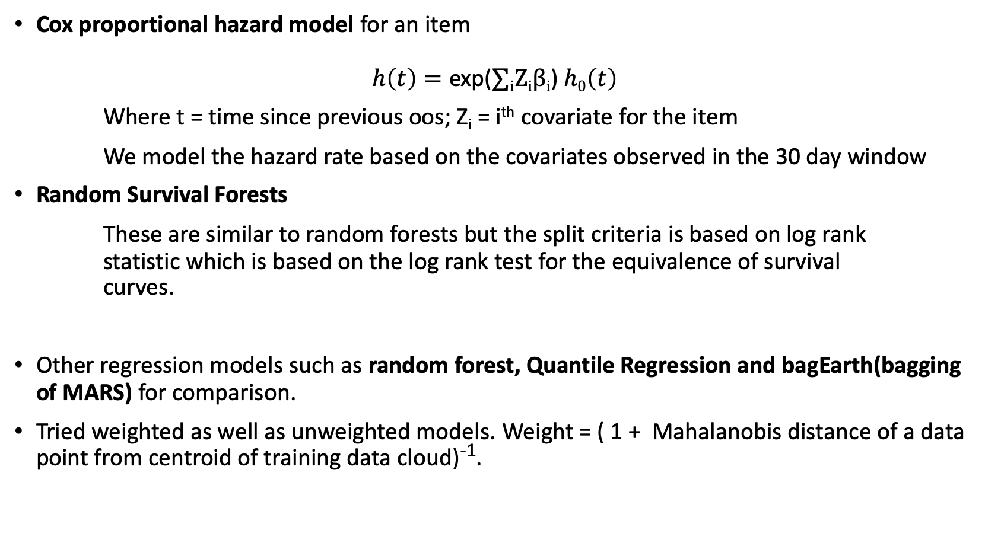
Brief explanation of models explored
Cox proportional hazard model for an item
$$h\left(t\right)=\text{exp}\text{(}∑\text{i}\text{Z}\text{i}β\text{i}\text{) }h0\left(t\right)$$
Where t = time since previous oos; Z_{i} = i^{th} covariate for the item
We model the hazard rate based on the covariates observed in the 30 day window
Random Survival Forests
These are similar to random forests but the split criteria is based on log rank statistic which is based on the log rank test for the equivalence of survival curves.
Other regression models such as random forest, Quantile Regression and bagEarth(bagging of MARS) for comparison.
Tried weighted as well as unweighted models. Weight = ( 1 + Mahalanobis distance of a data point from centroid of training data cloud)⁻¹.

Slide 10
Covariates
We will consider a window of 30 days before the OOS occurrence and we will consider the following covariates:-
Proportion of days with promotion
Proportion of days there was out of stock
Maximum length of out of stock
Sales of the item
Inventory level
Rate of change of sales by dividing the window into 4 quarters, etc.

Slide 11
How does the structured data looks?
Item 1 oos : 0 0 0 1 1 1 1 0 1 1 0 0 0 1 0 1 == 0 0 0 1 0 1 0 0 0 1 0 1(t_11=t_current) [after re-arrangement]
Item 2 oos : 000001000111110011111000000 = 0000010001001000000(t_19=t_current)
item | Time Pt. | Successive_gap_between oos incidence | Oos recurrence | Promo_cov_1 | Promo _cov_2 | Sales_ cov_1 | Sales_ cov_2 | NOTE
1 | 3 | 3 (counting from start=0) | 1 |  |  |  |  | First oos observed at time point 3. We start counting time from zero
1 | 5 | 2(counting from prev occurrence point) | 1 |  |  |  |  | Second OOS is observed at time point 5
1 | 9 | 4 | 1 |  |  |  |  | All the covariances at time t is based on raw-historical date till time t-1
1 | 11= t_current | 2 | 1
2 | 6 | 6 | 1
2 | 10 | 4 | 1
2 | 13 | 3 | 1
2 | 19=t_current | 6 | 0 |  |  |  |  | The current time point is 19 and after t=13, we have not observed any oos

Slide 12
A unique advantage of Survival Analysis based approach
1 0.8
0.6
0.4
0.2
0
We get “soft” estimate in terms of probability through survival curve
Probability(of OOS at time t* | historical data) as function of t*
Decide, depending on the supply chain status, when we can replenish and evaluate expected loss in that choice
The probabilistic oos output from multiple items can help us to prioritize replenishment schedule by minimizing expected loss.
Item 2
OOS Probability
Item 1
0 5 10 15
Days

Slide 13
Item – 949663(Lays), Location - 3056
If we train the survival analysis models over this item-location pair, we get survival probabilities as an output. The following slides show the out of stock probability curves for both the models.
So, for assessing our prediction we need to choose a threshold such that when our predicted probability of OOS occurrence exceeds that threshold, that is usually the day of actual OOS occurrence.

Slide 14
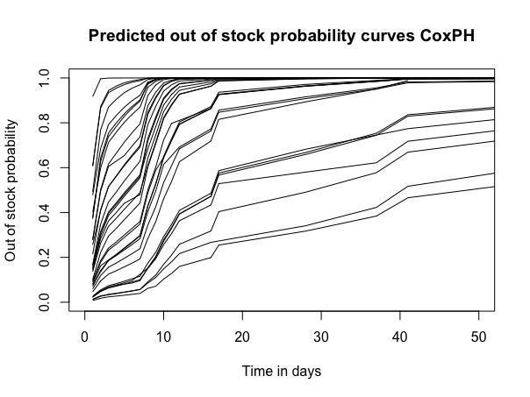
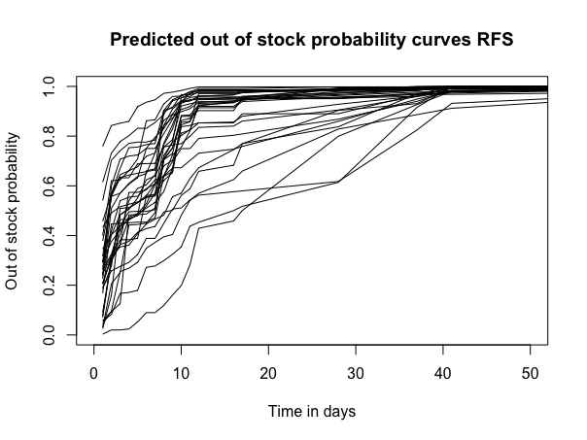

Slide 15
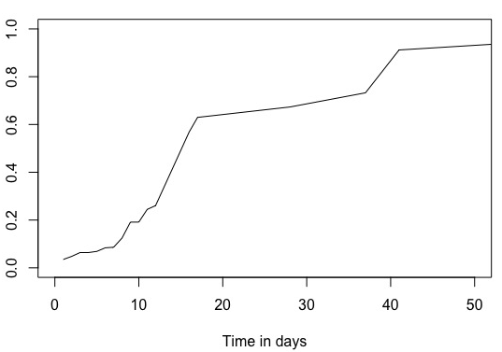
Threshold
I tried out with different values of the threshold and saw that the models were often overpredicting with p = 0.8 and underpredicting with p = 0.5
0.6, 0.7 seem to be good values for the threshold.
Probability

Slide 16
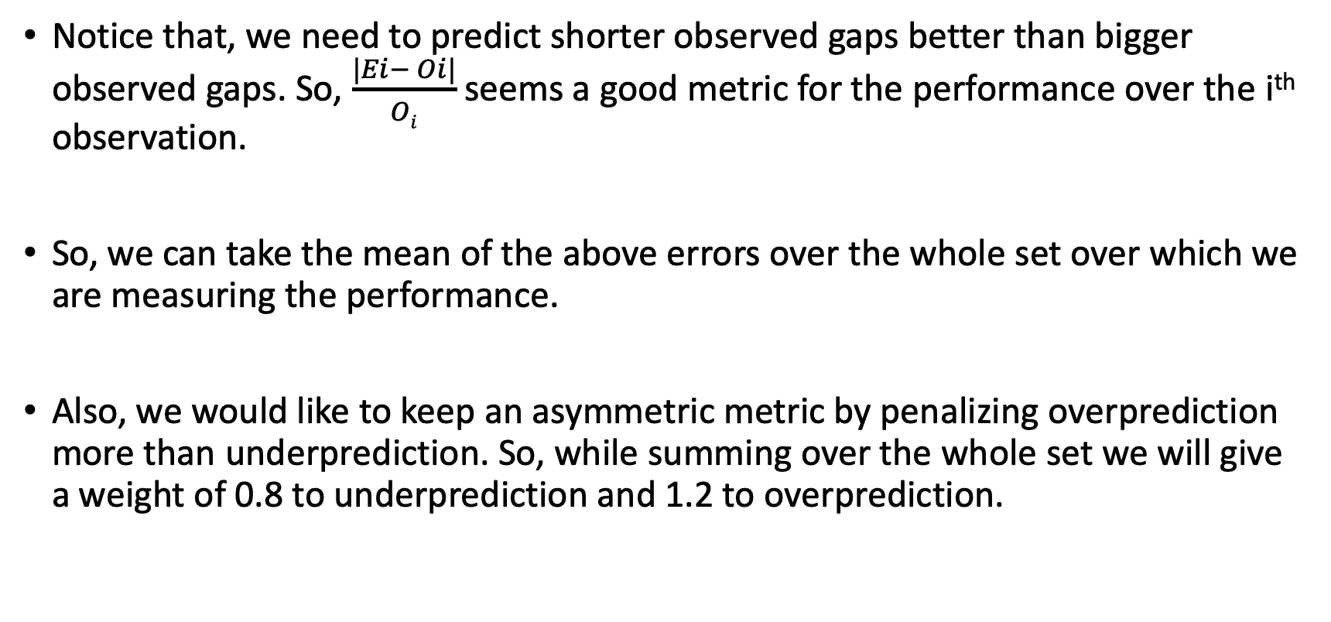
Metric for performance
Notice that, we need to predict shorter observed gaps better than bigger observed gaps. So, $\frac{|Ei− Oi|}{Oi}$ seems a good metric for the performance over the i^{th} observation.
So, we can take the mean of the above errors over the whole set over which we are measuring the performance.
Also, we would like to keep an asymmetric metric by penalizing overprediction more than underprediction. So, while summing over the whole set we will give a weight of 0.8 to underprediction and 1.2 to overprediction.

Slide 17
Results
For validation, we are using leave-one-out
Model | 949663_3056 (Lays Onion Potato Chips) | 949663_656 (Lays) | 17508944_672 (Triscuit) | 14578290_896 (Lays Vinegar Potato Chips)
RFS 0.7 w | 0.737909 | 0.81506803 | 0.814269 | 0.7671689
RFS 0.6 w | 0.747333 | 0.77710317 | 0.6985843 | 0.7853454
CoxPH 0.7 w | 0.657076 | 0.75488073 | 0.8620121 | 0.5454205
CoxPH 0.6 w | 0.70644 | 0.79593276 | 0.7602979 | 0.77267
bagEarth w | 0.592018 | 0.7793425 | 0.7097865 | 0.6307783
RFS 0.7 | 0.765175 | 0.5845069 | 0.6406736 | 0.723976
RFS 0.6 | 0.69071 | 0.66608844 | 0.8831702 | 0.8135419
CoxPH 0.7 | 0.702172 | 0.65447199 | 0.6675811 | 0.4778157
CoxPH 0.6 | 0.579055 | 0.66286244 | 0.5885309 | 0.5328058
rf | 0.788784 | 0.76355066 | 0.6492994 | 0.6370223
Notes:
Introduce the replenishment phenomenon to reason poor performance

Slide 18
Replenishment = Censoring
Whenever inventory is replenished, the observation is censored as we intervened and the past scenario is no more observable.
This is basically a fresh start with the replenished stock.
Previously the replenishment effect on time to OOS was ignored; now we accommodate it via censoring perspective.
Notes:
As the predicted output should be number of days to OOS assuming there is no replenishment, the model will be trained in the same way.

Slide 19
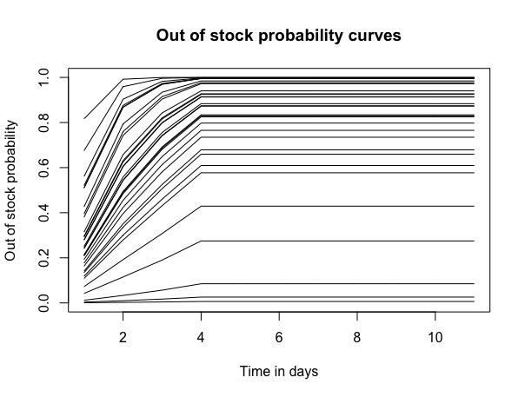
Results
Model | 949663_3056 (Lays Onion Potato Chips) | 949663_656 (Lays) | 17508944_672 (Triscuit) | 14578290_896 (Lays Vinegar Potato Chips)
Cox 0.3 | 0.1940632 | 0.280455 | 0.244228 | 0.235537
RFS 0.3 | 0.5295392 | 0.39177 | 0.466845 | 0.712476
Cox 0.3_w | 0.2181288 | 0.303292 | 0.239784 | 0.218591
RFS 0.3_w | 0.4823656 | 0.344856 | 0.449008 | 0.552591
Cox 0.4 | 0.2223712 | 0.315138 | 0.289464 | 0.212648
RFS 0.4 | 0.4827957 | 0.354733 | 0.449702 | 0.526591
Cox 0.4_w | 0.2315878 | 0.307462 | 0.292798 | 0.237105
RFS 0.4_w | 0.4849462 | 0.344833 | 0.505655 | 0.446514

Slide 20
Scaling Up
Successful experimentation with SparkR done.
Sparse data scenarios where model cannot be fitted require simpler fallback alternatives to estimate OOS probabilities.

Slide 21
Learnings
Preparation of data using Hive queries
Survival Analysis and its applications
Using sparkR and understanding its data flow.

Slide 22
Next steps
Exploring a mixed effects model which considers an item as a random effect and other covariates as fixed effect at a location.
Exploring sparse data scenarios where discussed models cannot be fitted

Slide 23
Appendix

Slide 24
Models
Random Survival Forests
These are similar to random forests but the split criteria is based on log rank statistic which is based on the log rank test for the equivalence of survival curves.
Based on the leaf nodes we reach to we can estimate the cumulative hazard function using the points in the leaf nodes and then using that we can estimate survival probabilities
BagEarth
This is bagging applied on Multivariate Additive Regression Splines.

Slide 25
OOS and Survival analysis correspondence contd.
Though fundamentally similar, survival approach does not care for the run length of a “recurrent event” presence
How long the machine is down before next up state
How long the relapsed disease takes to subside and become dormant
OOS is also “OOS run length” agnostic
After replenishment of an OOS, start of sale for any item is a new start
We consider the start time of any OOS run as the onset of recurrence and discard the rest “in oos” sequence
So 1 1 0 0 0 0 1 0 1 1 1 1 1 0 0 is re-arranged as 1 0 0 0 0 1 0 1 0 0
ignored

Slide 26
References
Code - https://git.target.com/Z004189/OOS_Exploration

